Slide 1
Surveillance Car: ESP32 Remote Control with Wi-Fi Camera
Team Members:
2310040080 – G. Ravi Teja
2310040084 – P. Nithish
2310040078 – S. Sreenivas
2310040073 – M. Akhil

Slide 2
Core System Architecture
The system integrates several key components. An ESP32 serves as the central control unit. A camera module captures video. A motor driver controls movement.
ESP32
Camera Module
Motor Driver
WiFi
The brain of the car. Handles WiFi, motor control, and video streaming.
Captures real-time video. Sends data to the ESP32 for streaming.
Controls the car's motors. Allows for precise movement.
Enables remote control. Streams video to a web interface.

Slide 3
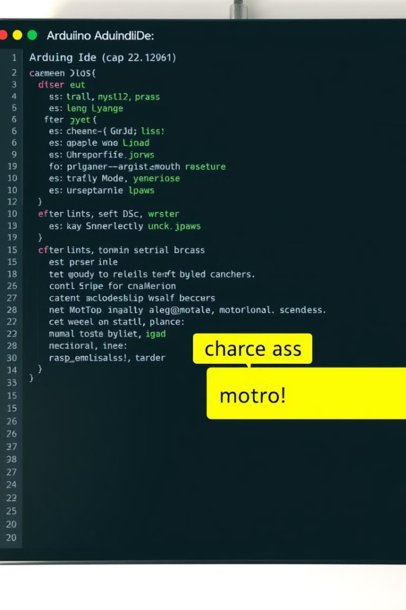



Software Development Essentials
Software development involves key tools. Use the Arduino IDE for coding. A web server manages remote access. Camera streaming delivers real-time video.
Arduino IDE
Develop and upload code to ESP32.
Web Server
Handle remote access and control.
Camera Streaming
Transmit video to the web interface.

Slide 4
Construction and Rigorous Testing
Construction requires careful assembly. Calibration ensures accurate performance. Network configuration enables remote access. Extensive testing validates functionality.
1
Assembly
2
Calibration
Physically connect all hardware components.
Fine-tune motor and camera settings.
3
Network Configuration
Set up WiFi for remote control.

Slide 5



Future Enhancements and Expansion
Future development includes exciting features. AI object detection enhances awareness. Autonomous navigation enables smart movement. Explore advanced capabilities.
AI Object Detection
Autonomous Navigation
Enhanced Security
Identify objects in real-time.
Self-guided movement through routes.
Advanced threat detection.

